Slide 1
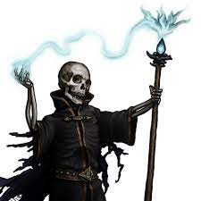
The Night of the Liche
Pitch Date: 12/18/2022 Update 1/8/2023
Release Date: 4/9/2023 61 Commits
Team Lead: Vince McKeown 6 Contributors

Slide 2

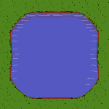
Vince McKeown
Ground Tiles
Dirt, and Pond tile sets
Pathfinding
Skeleton
Drawn in 4 directions
Collisions
Player to Alchemist/Skeleton

Slide 3
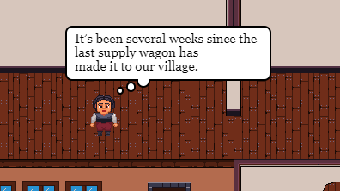
Christer “McFunky Pants”
Thought Bubbles

Slide 4
H Trayford
World Building
Additional data for level/area files to support drawings
Graveyard
New Area
Town
New Area
New Area

